Slide 1



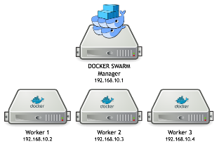





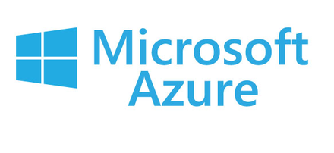



Click2Cloud Shift’M
Project Goal
Kubernetes Dashboard
To containerize Web app/API, by providing the source code present under GitHub repository using the available builder images as Python, Perl, Ruby, NodeJS, .NET Core 2.0, .NET Legacy etc. under Click2Cloud Shift’M tool.
Repository
Kubernetes Cluster
Project Delivery Status
Team is currently modifying, stabilizing the Click2Cloud Shift’M tool. Once this is done, the product URL will be shared with client for getting further inputs. And soon after the POC, SOW and NDA will be signed and the product will be handed over to client.
Repository
Click2Cloud Shift’M
Cloud Service provider
Supporting Plan to Make Delivery Successful
How can we make the client successful?
Roadmap for next phase
Team will ready the tool based on the requirement well before the client site POC commencement date.
If client faces issues accessing Click2Cloud Shift’M tool, one resource will coordinate with them to solve their issues.
By helping them to efficiently containerize source code, present under any Source Control Repository with any required builder image.
Click2Cloud Shift’M tool currently supports only 8 builder images and GitHub as a single Source Control Repository. In the next phase we are planning to integrate the remaining builder images and TFS, Bitbucket as a Source Control Repository.

Slide 2
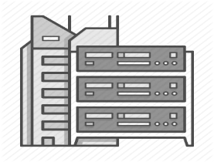
Click2Cloud Shift’M Tool
Overview:
Repository
Kubernetes Cluster
Click2Cloud Shift’M is a tool that makes it easy to containerize your source code and push created docker image into your registry.
User can containerize the web app/api, by providing just the git source repo, and using Click2Cloud builder images for Python, Perl, Ruby, NodeJs, .NET Core 2.0, .NET Legacy and much more.
Kubernetes Dashboard
Cloud Service provider
Shift’M
Repository
Local Docker Infrastructure
High Level Features:
Contact Us
User can manage kubernetes cluster by using kubernetes dashboard and also containerize his application source code by using Click2Cloud Shift’M tool.
Push application source code docker image into docker registry for future use.
The main advantage of using Click2Cloud Shift’M tool for building docker images of the source code is the ease of use for developers.
As a builder image author, you must understand two basic concepts in order to provide the best possible performance: The build process and Shift’M script.
Click2Cloud Inc.
1000 124th Ave NE
Bellevue, WA 98005, USA
+1 (425) 748 9666
pm@click2cloud.net
Visit us on the web:
www.click2cloud.net

